Slide 1
Predicting sale prices of homes in Ames, IA
By: Cassy Clark

Slide 2
Objective
Create a model that would predict the sale prices for homes in Ames, Iowa
Given training data set, testing data set, and data dictionary
Steps taken: EDA, Feature Engineering, Lasso, Ridge, Linear Regression
Why should I care about Ames, IA?

Slide 3
Data Cleaning and EDA
Train shape: (2051, 81) → (2051, 121)
Test shape (878, 80) → (878, 119)
Addressing null values
Is it a missing value or does the house not have one?
What about lot frontage?
Any others?
New columns created: total bath, total sqft, total sqft*qual, fireplace*fireplace quality, beds*baths
Dummy columns: central air, street, neighborhood, alley, garage type

Slide 4
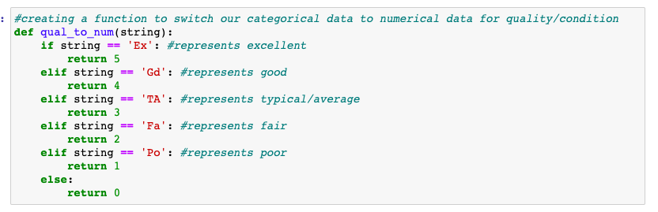
Data cleaning cont.
Global functions to transform categorical ranking to numerical ranking
Used on both training and testing
Difference between ordinal and Nominal
Nominal data dummied

Slide 5
Feature Engineering
Created mini data frames to check for multicollinearity between different features and the target variable of sale price
Outdoors
Garage
Neighborhood
Etc
Dropped columns in training set that were not in testing set
Green Hills
Landmark
Variables created from feature engineering:
Total sqft
Total sqft*quality
Fireplace*fireplace quality
Beds*baths

Slide 6
Models Used
Multiple linear regression, lasso, ridge
Train, test, split data
Various feature combinations for independent variables
Baseline RMSE: $79,239

Slide 7
First Round of Model Testing
Multiple Linear Regression
Split 80/20
R2 score of 0.830 and 0.862
RMSE: $28,644
Lasso
Same variables as linear regression model
Multiple alphas used, best score I found was with the default alpha of 1
R2 scores: 0.831 and 0.862
RMSE: $28, 642
Ridge
Same features as linear regression
Best alpha: 100
R2 scores: 0.829 and 0.865
RMSE: $28,300

Slide 8
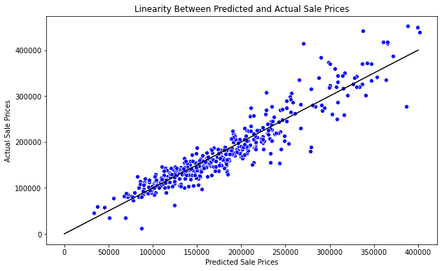
Best Model
Multiple Linear Regression
Split 80/20
R2 score: 0.838 and 0.872
RMSE: $27,599

Slide 9
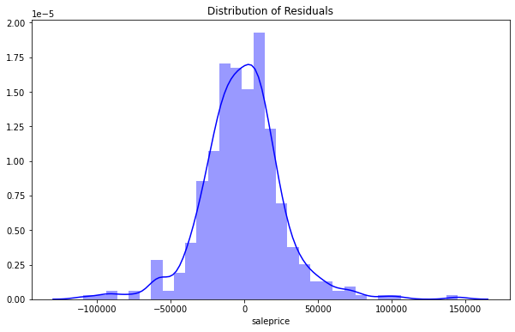
Distribution of Residuals

Slide 10
Relationship between different features
Overall quality: $7,414
Total baths: $10,633
North Ridge neighborhood: $39,366
North Ridge Heights neighborhood: $42,857
Stonebrook neighborhood: $60,703
Exterior quality: $11,046
Kitchen quality: $11,399

Slide 11
Conclusions
Best model recap
Model usage
Next steps

